Slide 1
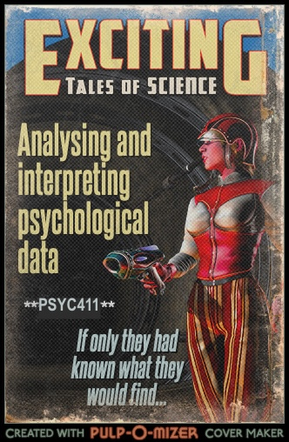

Slide 2
Contact info
Professor Padraic Monaghan
Email: p.monaghan@lancaster.ac.uk
Office: Room C5, Fylde
Office hours: email to set up a time to meet

Slide 3
Module aims
Be able to utilise the popular and powerful R statistical application for your own research
Learn to identify the data analysis approach that can be applied to test theoretical beliefs against evidence
Recognise and apply appropriate statistical tests to different data
Describe the findings from analysing data effectively in text
Write a journal-style short report of a data analysis
Relate data analysis findings to scientific insights, linked to psychological theory

Slide 4
Assessment
Assessment will be 100% by coursework
A series of short assignments every three weeks (due Friday of weeks 3, 6, and 9, contributing 10%/15%/15% of the grade)
  The assignments are designed to make sure you develop the key skills of data preparation and analysis as the course progresses.
A short research report (due after Christmas break, contributing 60% of the grade).
  Providing a series of short answers to questions, reporting on your analysis of a data set.

Slide 5
Structure and set-up of the course
Ten weeks of material
Within each week there are two activities:
  Recorded lectures
    Background to the theory, discussion of the tests, introduction to the practical
  Practical class
    Materials to work through in conducting your own data analyses
    Foundations, consolidation, extension

Slide 6
Structure and set-up of the course: how it works
Here is how it works
  Step 1. Watch the lecture(s)
  Step 2. Get together in your practical group to go through the practical workbook.
  Step 3. Attend the practical class as a group to go through the workbook
    Tutors will be available to respond to the questions/queries
  Step 4. In weeks 3, 6, 9 complete the assignment and submit by Friday 8pm

Slide 7
Objectives for Week 1
By the end of Week 1, you should be able to:
Understand the importance of data analysis and statistics
Identify types of data in psychology (nominal, ordinal, interval, ratio)
Understand means and standard deviations
Understand standardized scores (Z-scores)
Use R-studio to begin to manipulate data, investigate means and standard deviations, and convert scores into Z-scores

Slide 8
What is the point? I
The task: children read a list of words as quickly as possible, with rose-tinted glasses and with clear-lense glasses
Wow! A 50% increase! They really work!!
  Or do they?
What more do you need to know about this study to be able to determine whether rose-tinted glasses help reading?
Clear-lense Glasses | Rose-tinted Glasses
50 words per minute | 75 words per minute
Ritchie, S. J., Della Sala, S., & McIntosh, R. D. (2011). Irlen colored overlays do not alleviate reading difficulties. Pediatrics, 128(4), e932-e938.
Available here: https://pdfs.semanticscholar.org/06ed/f49b323e86cc115ca05d882d44afef6b4848.pdf

Slide 9
What is the point? II
Clear-lense Glasses | Rose-tinted Glasses
50 words per minute | 75 words per minute
What more do you need to know about this study to be able to determine whether rose-tinted glasses help reading?
  Was the test a good test (was it valid, was it reliable)?
  How many children were tested? Were they tested in both conditions, or just one? If just one, how were they assigned to groups?
  What is the variability of the mean?
    Is 25 words per minute difference meaningful?
    Is it a statistically significant difference?
Ritchie, S. J., Della Sala, S., & McIntosh, R. D. (2011). Irlen colored overlays do not alleviate reading difficulties. Pediatrics, 128(4), e932-e938.
Available here: https://pdfs.semanticscholar.org/06ed/f49b323e86cc115ca05d882d44afef6b4848.pdf

Slide 10
What is the point? III
Clear-lense Glasses | Rose-tinted Glasses
50 words per minute | 75 words per minute
The 50 versus 75 words per minute difference in Ritchie et al. (2011) came from a group of only 3 of the children.
They tested a further 57 children, and found absolutely no difference.
  This raises another question about how we can test whether there is no difference. But that’s for another day…
What we can conclude from Ritchie et al.’s study is “there is no evidence for a difference”.
Ritchie, S. J., Della Sala, S., & McIntosh, R. D. (2011). Irlen colored overlays do not alleviate reading difficulties. Pediatrics, 128(4), e932-e938.
Available here: https://pdfs.semanticscholar.org/06ed/f49b323e86cc115ca05d882d44afef6b4848.pdf

Slide 11
The point: critical about claims
We should be critical over claims about what results show
We can be informed about study designs
We can interpret the meaning of data, analyse it, and determine when it relates to theories, and when it supports conclusions
“88.2% of statistics are made up on the spot” (Vic Reeves)
But: you can’t make statistics mean anything
And: we are not fed up of so-called experts
BBC article on Michael Gove comments on fed up of experts
Krause, N. M., Brossard, D., Scheufele, D. A., Xenos, M. A., & Franke, K. (2019). Trends—Americans’ trust in science and scientists. Public Opinion Quarterly, 83(4), 817-836.

Slide 12
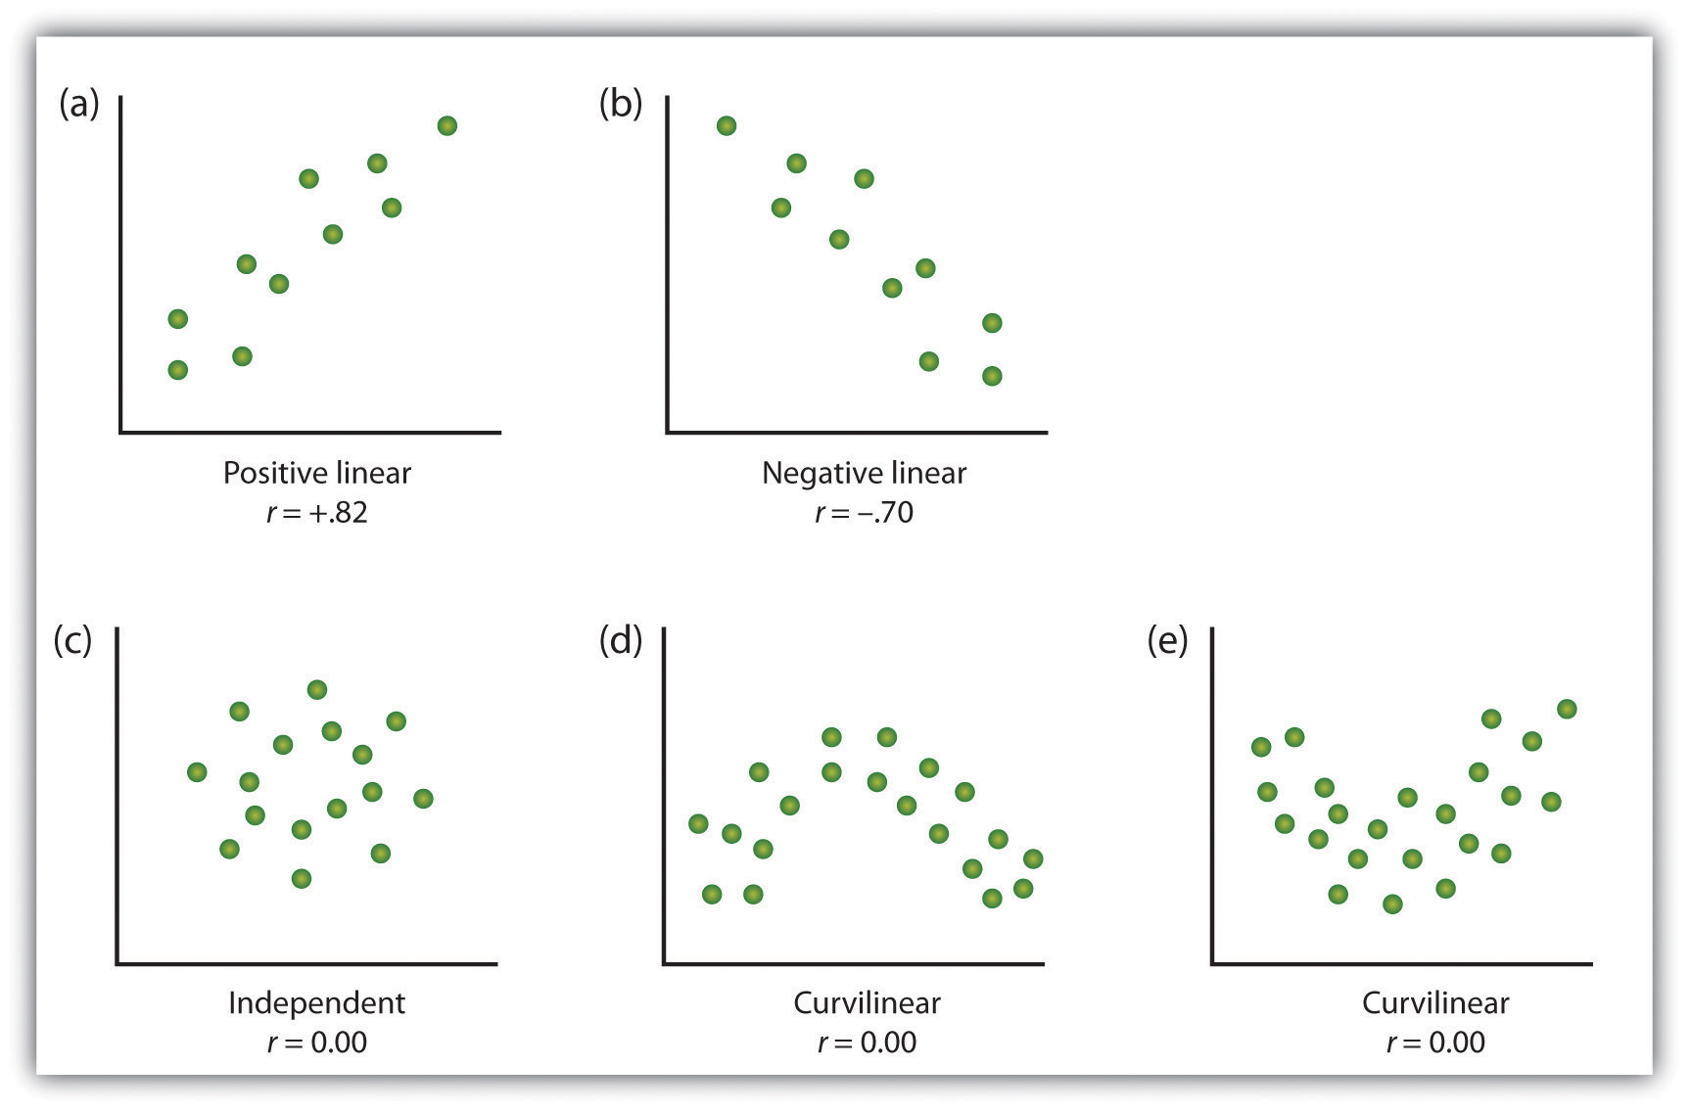
The point: patterns of data
Examining patterns in data (critically)
Finding the right way to describe and test these patterns
https://opentextbc.ca/introductiontopsychology/chapter/2-2-psychologists-use-descriptive-correlational-and-experimental-research-designs-to-understand-behavior/
Notes:
Here is an example. On the x axis is the ratings of emotionality of tv adverts, and on the y axis is the sales success of the product. What relationship does each graph show?

Slide 13
Summary
What’s the point of statistics?
  Understand and be critical of claims relating to data
  Link data to theories

Slide 14
Module outline week1-5
Week 1: Introducing data, introducing Rstudio
Week 2: Manipulating data, using Rstudio
Week 3: Exploring data and creating figures and graphs, using Rstudio
Week 4: Categorical data and the chi-squared test – testing random versus structured?
Week 5: t-tests – testing whether two groups are different

Slide 15
Module outline week6-10
Week 6: Introduction to your research report
Week 7: Measurement, hypotheses, associations (correlations)
Week 8: Predicting behaviour: the linear model
Week 9: Data visualisation
Week 10: Predicting behaviour: developing the linear model

